Slide 1
Semantic Segmentation
Deep Learning and Image Processing

Slide 2
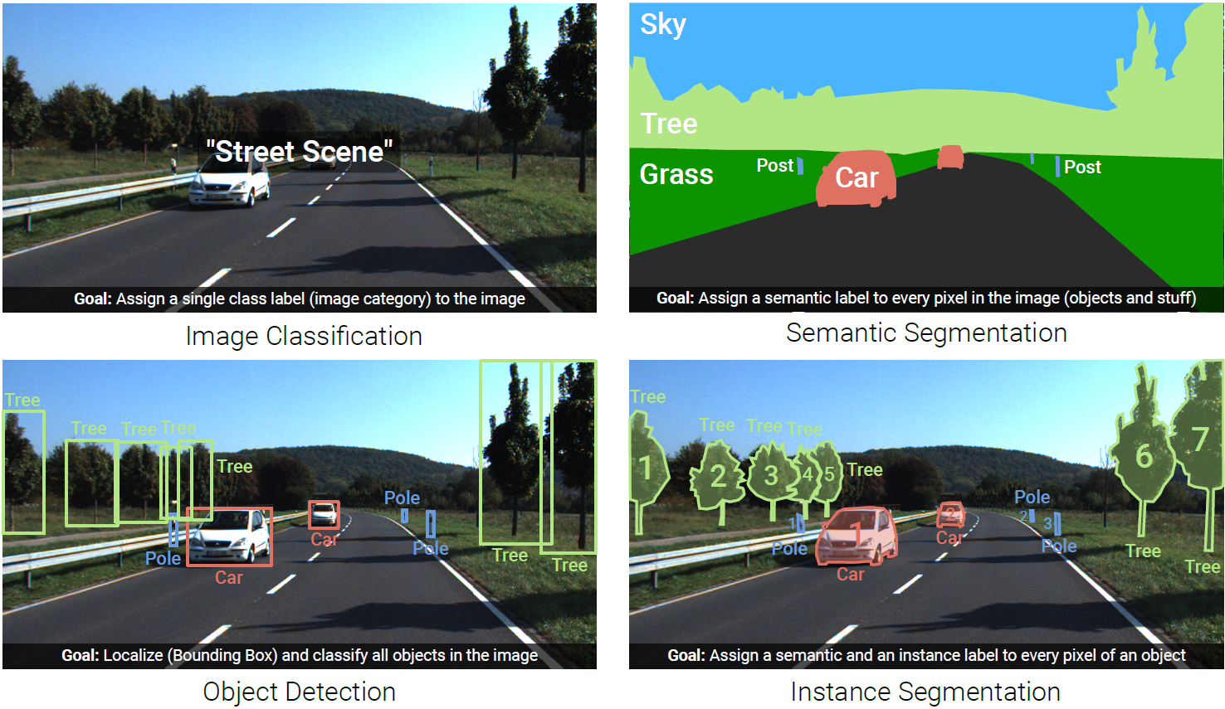
Image Understanding (Recognition)
combination of both: panoptic segmentation

Slide 3
A Few More Image Data Sets

Slide 4
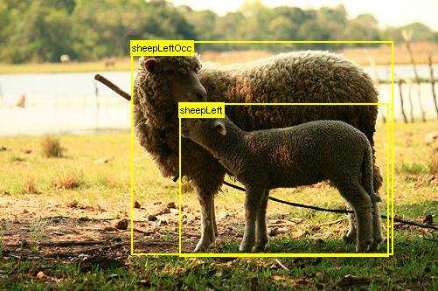
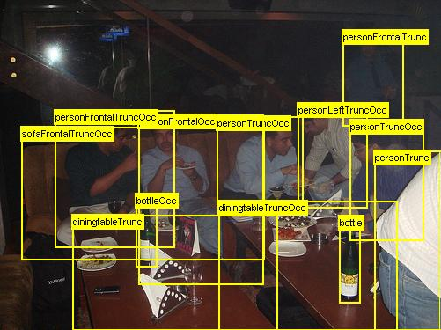
PASCAL VOC Data Set
PASCAL Visual Object Class challenge
widely used as benchmark for object detection and semantic segmentation
20 object categories such as person, sofa, sheep, car, …
11530 annotated images
available annotations: pixel-level segmentation, bounding boxes, object classes

Slide 5
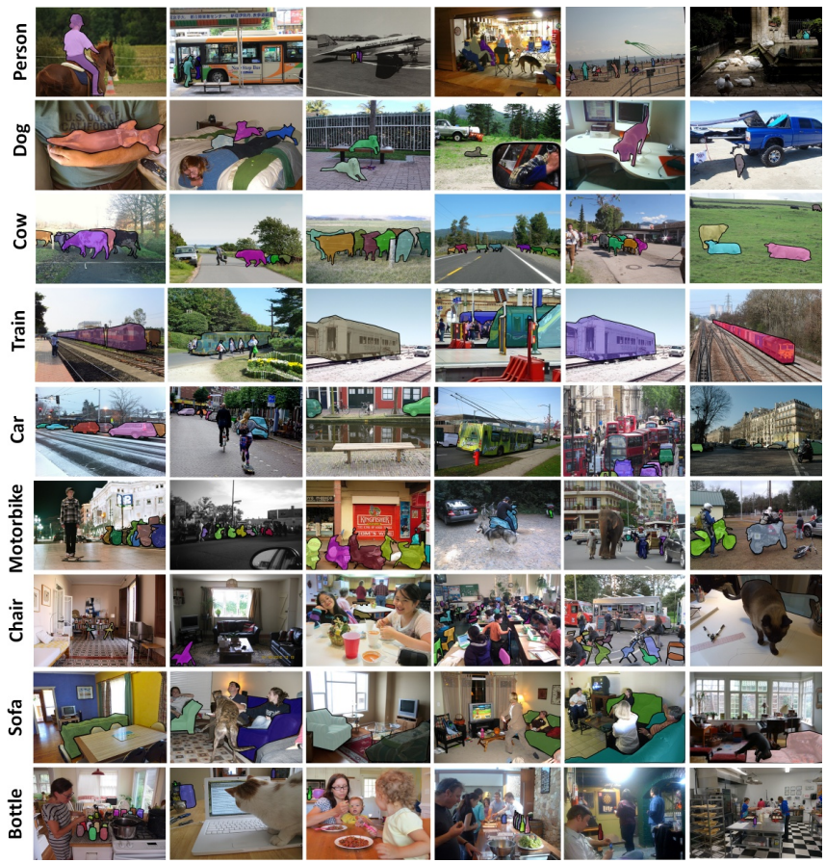
MS COCO Data Set
Microsoft Common Objects in Context
images of complex everyday scenes containing common objects in their natural context
91 objects types
2.5 million annotated instances in 328k images → instance segmentation

Slide 6
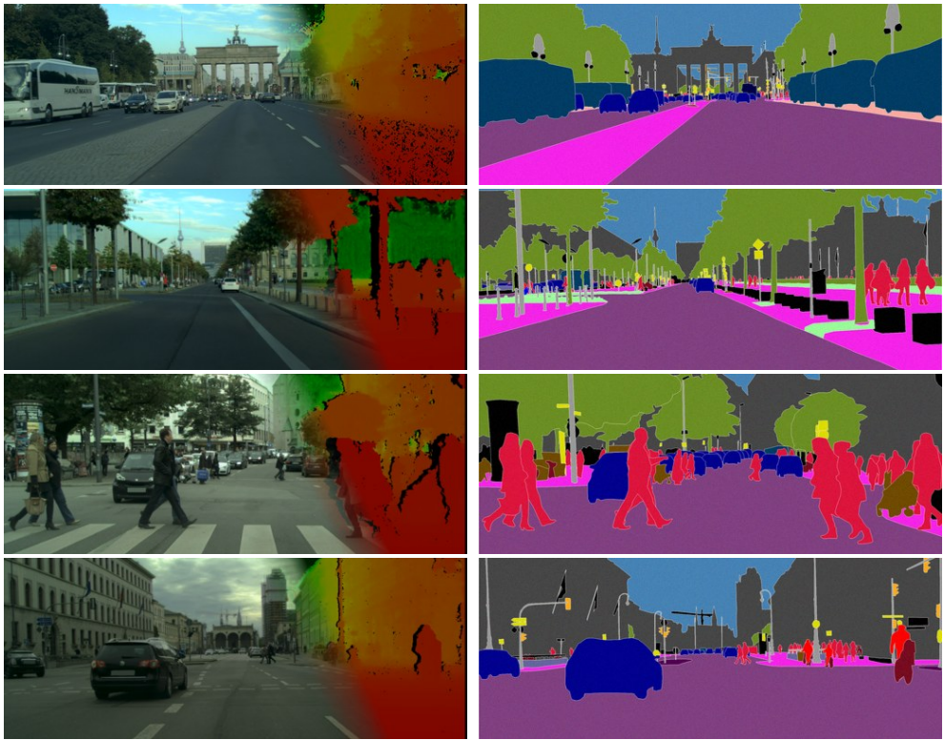
Cityscapes Data Set
(depth map)
annotation
goal: semantic understanding of urban street scenes (captured in 50 cities)
pixel annotations for 30 classes (person, car, building, …)
5000 fine-annotated and 20000 coarse-annotated images
source

Slide 7
Semantic Segmentation

Slide 8
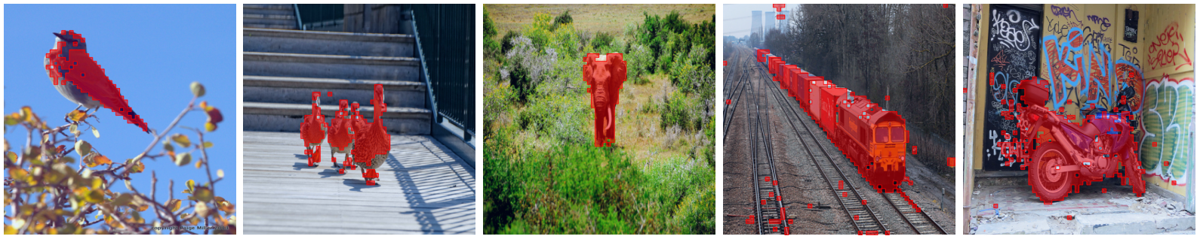
Object Segmentation from DINO
thresholding self-attention map of last layer:
not a full segmentation mask though …
source

Slide 9
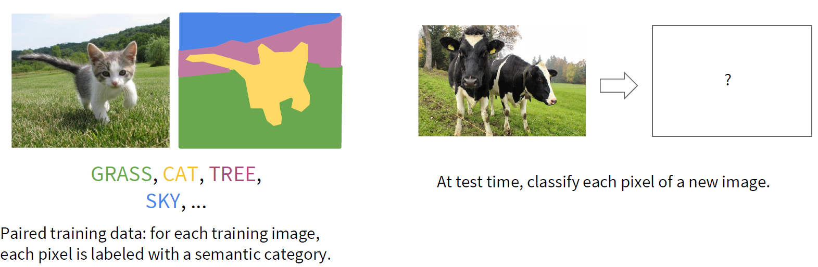
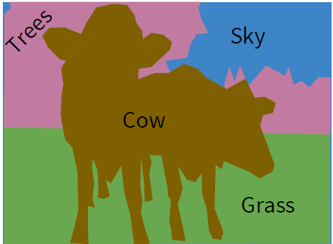
Classification of Each Pixel
segmentation: no objects, just pixels
minimize sum over classification losses (cross-entropy loss at every output pixel)

Slide 10
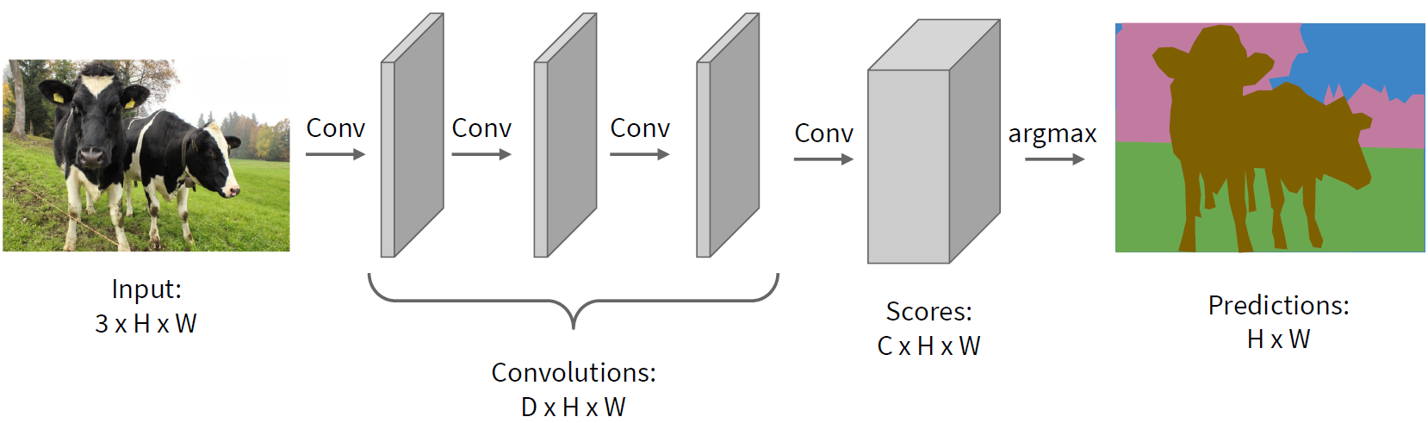
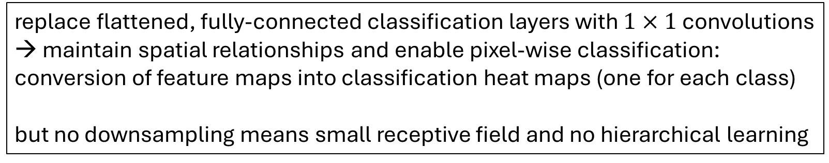
Idea: Fully Convolutional, No Downsampling
stride 1,
padding
→ small kernels
feature maps
categories
replace flattened, fully-connected classification layers with $1×1$ convolutions
→ maintain spatial relationships and enable pixel-wise classification: conversion of feature maps into classification heat maps (one for each class)
but no downsampling means small receptive field and no hierarchical learning

Slide 11
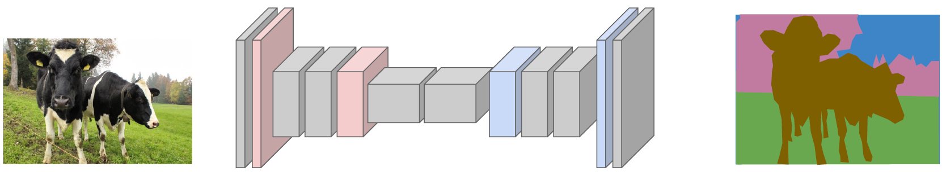
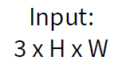
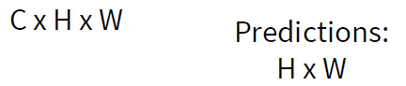
Upsampling to the Rescue
Fully Convolutional Networks
typical spatial feature extraction: convolution and pooling layers → downsampling
upsampling layers to restore original image size
pixel-wise classification
different options for down- (pooling, strided convolution) and upsampling ...

Slide 12
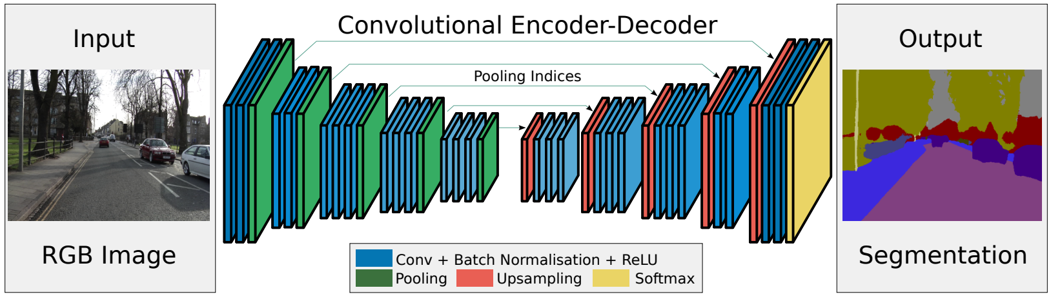
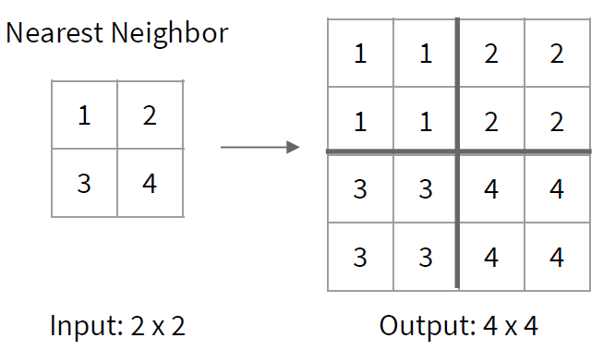
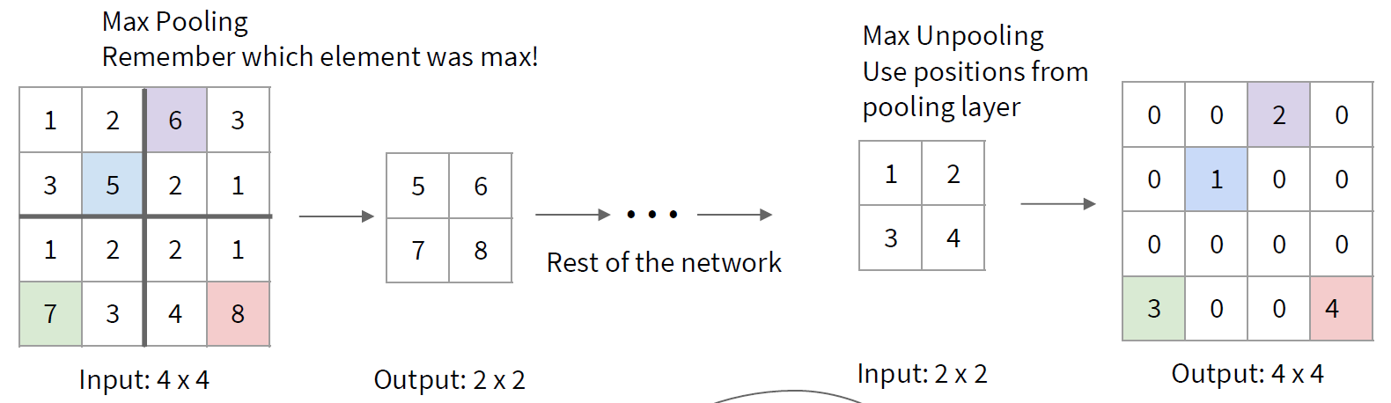
Reverse Pooling
unpooling (recording max positions from pooling)
resampling (no learned parameters)
source
filled with learned parameters in subsequent convolution

Slide 13
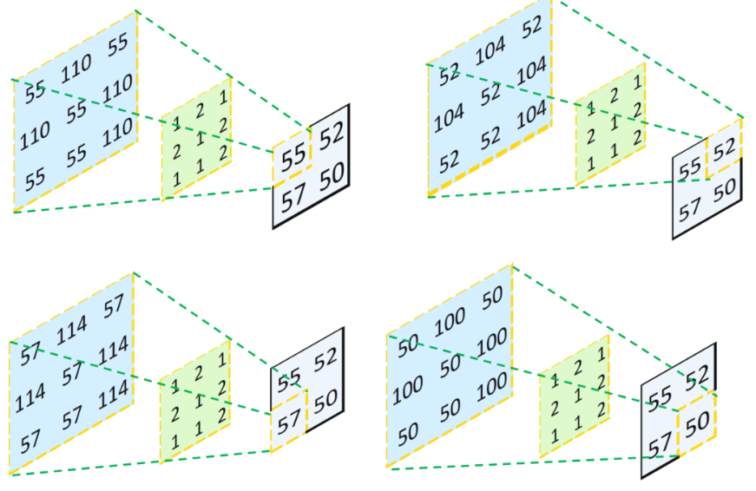
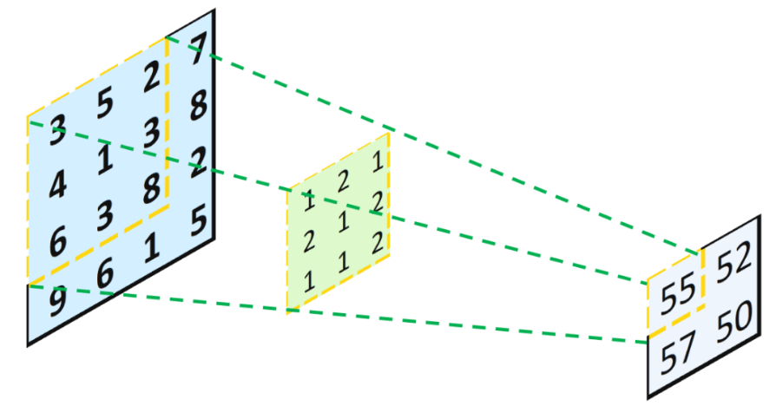
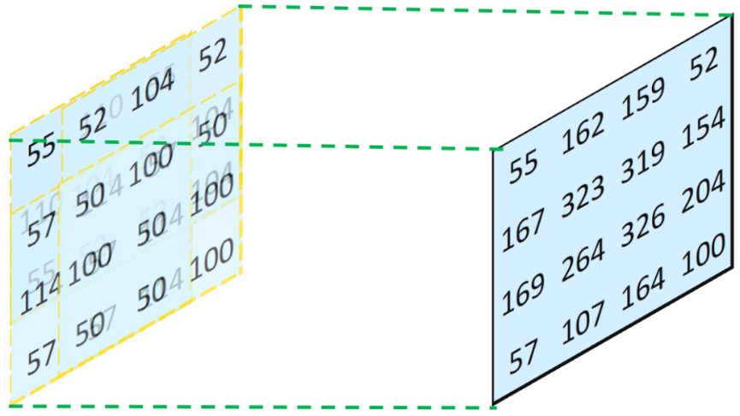
Reverse Convolution
transposed convolution
convolution
combine and sum overlaps:
not inverse convolution
→ additional learned parameters
source

Slide 14
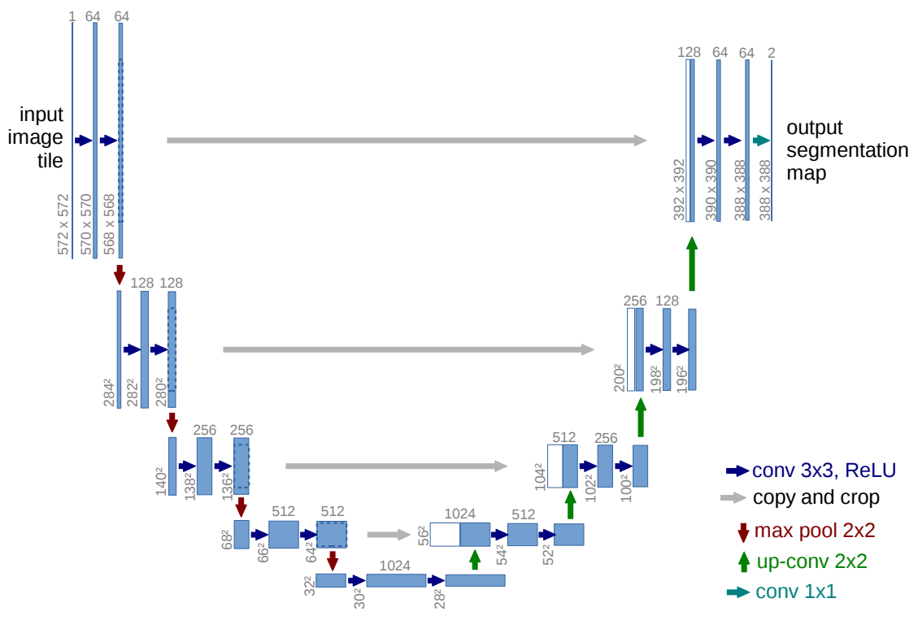
U-Net
number of channels / feature maps
just two classes
skip connections
also used for learning of depth maps, image synthesis (diffusion), ...

Slide 15
Aside: Autoencoders

Slide 16

Autoencoder
for images:
convolutions
transposed convolutions
(deep) encoder network
(deep) decoder network
learned together by minimizing differences between original input and reconstructed input (expressed as losses)
compressed intermediate representation: dimensionality reduction
(alternative to PCA)
unsupervised learning
source

Slide 17

Denoising Autoencoder
goal: avoid overfitting and improve robustness of plain autoencoder
learn to remove noise of distorted input $\tilde{x}$ → restore original input $x$
similar to dropout
source
alternative to deconvolution (image restoration)

